Slide 1

Lecture 6 Java Internationalization Part 2
Reference:
Java-Tutorials/tutorial-2015/index.html

Slide 2
Objectives
How to specify cultural symbols in properties file?
How to create a compound message?

Slide 3
Contents
Formatting Date and Time
Specifying cultural symbols in properties files
Compound Message
Demonstrations

Slide 4
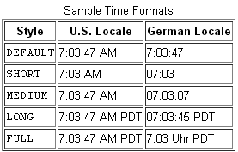
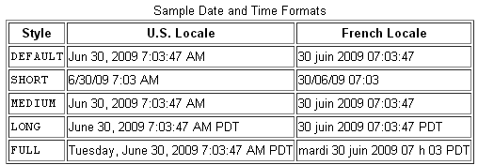
1-Formatting Date and Time

Slide 5
Formatting Date and Time…

Slide 6
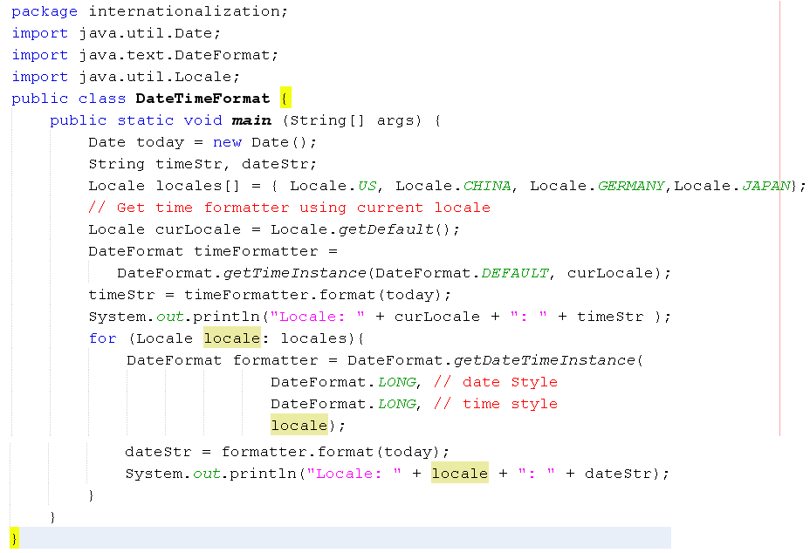

Demo 2: Formatting Date/Time…

Slide 7
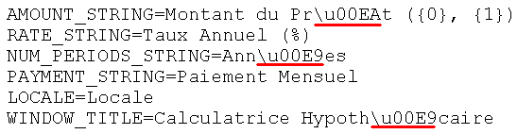
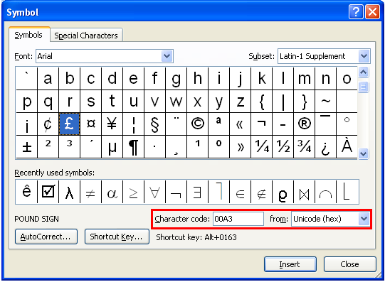
2- Cultural Symbols in Property File
Cultural Symbols: Alphabets, Digits, Currency symbol…
Use hexadecimal Unicode for particular symbols (\uXXXX).
You can use the function “Insert symbol” of the MS Word to find Unicode of a symbol.
tutorial-2015/i18n/format/examples/resources/ Resources_fr.properties

Slide 8

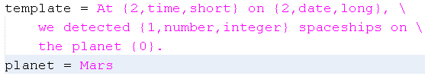
3- Compound Message
Compound message = string template + embedded data Example:
In the message’s template, marks must be used. Example:
The character ‘\’ is used as a concatenation
To mix data to the template, an array of objects are used, number in a mark is the object’s index in this array. Syntax for a mark: { index, type, format}

Slide 9
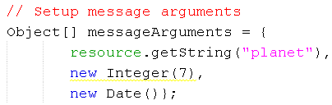
Compound Message…
Index=0
Index=1
Index=2

Slide 10
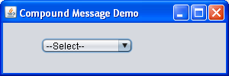
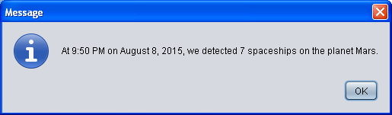
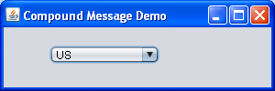
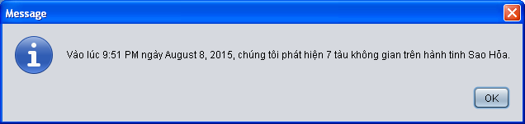

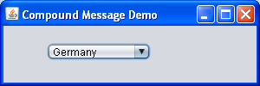

Demo 3

Slide 11
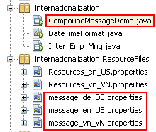

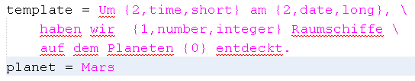

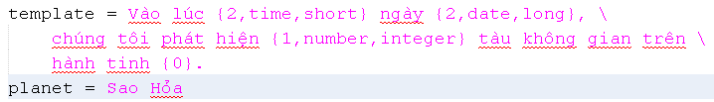
Demo 3…
Model
--Select—
US
VietNam
Germany

Slide 12
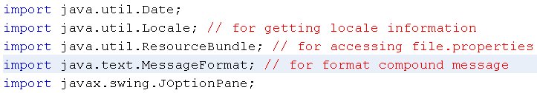
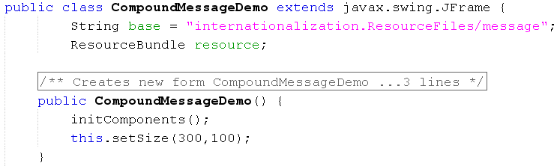
Demo 3…

Slide 13
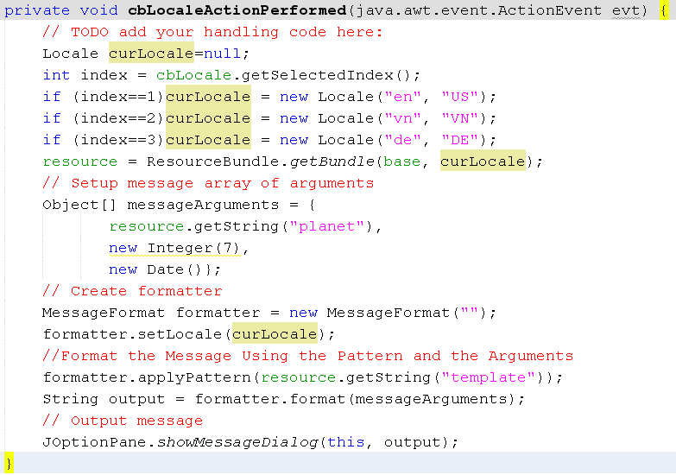
Demo 3…

Slide 14
Summary
Formatting Date and Time
Specifying cultural symbols in properties files
Compound Message

Slide 15
Thank You

